Slide 1
GO Bond 2 supports the Libraries at the University of New Mexico - Albuquerque

Slide 2
Collaboration with NM Libraries
New Mexico Consortium of Academic Libraries Statewide Purchases

Slide 3
Overall Benefits of the NMCAL Collaborative Purchase
Helps to improve efficiency and reduce cost
Provides core set of resources for all NM college students
Facilitates transition from 2-year to 4-year schools

Slide 4
Provides essential resources for professional programs and undergraduate/graduate students
Academic Search Complete:
Upper-level UNM Law and Masters of Studies in Law students routinely use in researching for their Law seminar class papers
Student staff on all three flagship Law Journals use to source-and-citation check for their editorial work, as well as their own scholarly pursuits
CINAHL:
CINAHL is an essential database for nursing and allied health students
Accreditation of nursing programs often requires CINAHL access
NMNEC nursing students have access through their local programs and UNM
45,160 searches performed in FY22
49,936 searches performed in FY22

Slide 5
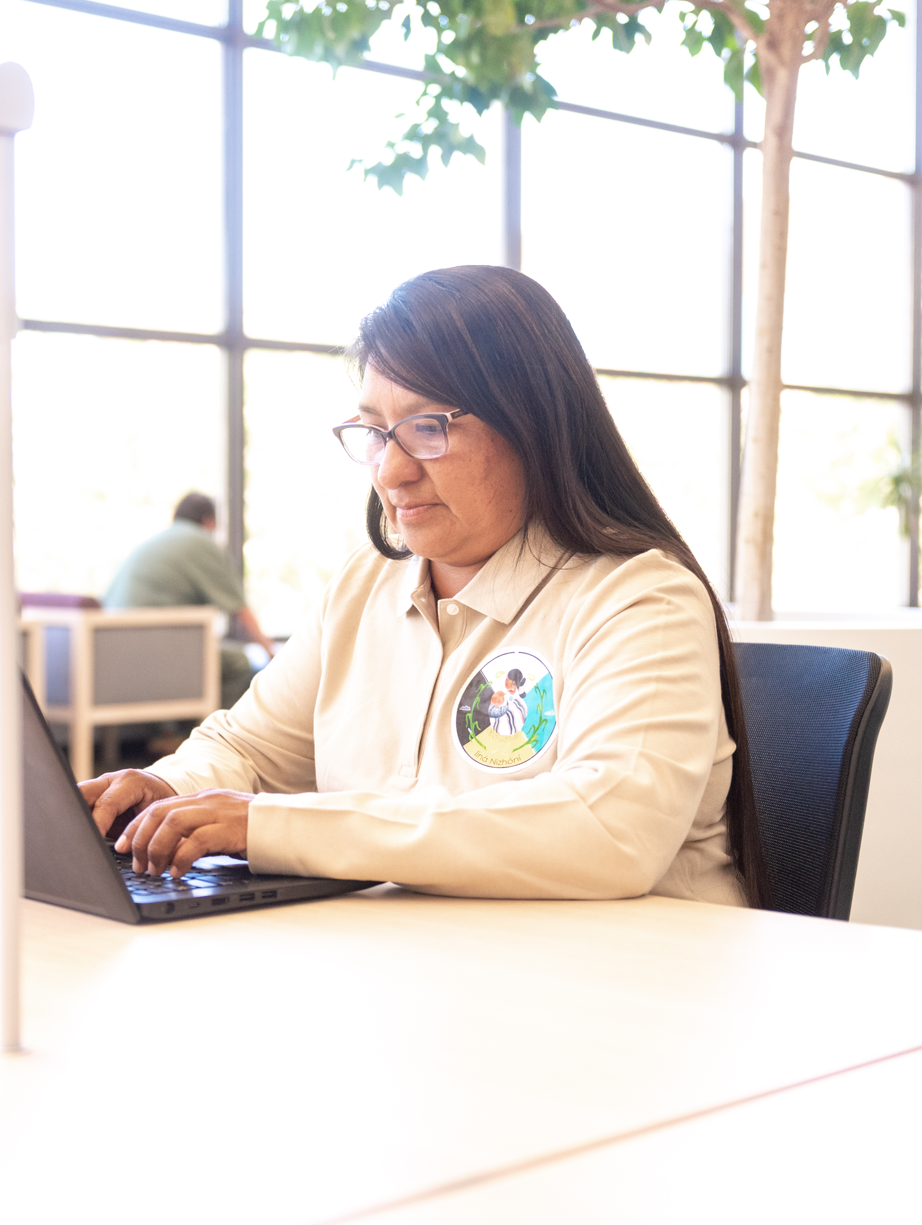
Key Resources for Faculty and Staff
Shared EBSCO databases
School of Law faculty use Academic Search Complete in pursuing their own research - including doing preemption checks - and for their interdisciplinary scholarly work
CINAHL supports nursing, occupational therapy, physical therapy, and many other allied health faculty with their research
Health professionals in the UNM Health system use CINAHL to improve quality, make clinical decisions, and promote better patient care

Slide 6
Supporting UNM Programs
UNM-specific resources purchased by the University Libraries, Law Library, and Health Sciences Library & Informatics Center

Slide 7
UNM University Libraries
2018 and 2020 GO Bonds funded:
265 books/eBooks to fulfill requests from students and faculty
Access to 40 online databases that support research and learning across a broad range of subjects

Slide 8
Examples of resources licensed with University Libraries' 2018/2020 GO Bond funds:
Business Source Complete
PsycINFO, PsycArticles, & PsycTESTS
WestLaw Campus Research
ProQuest Dissertations & Theses
Wildlife & Ecology Studies Worldwide
IEEE/IET Electronic Library
Bibliography of Indigenous Peoples in North America
Digitalia Hispanica

Slide 9
University Libraries' GO Bonds provided access to essential resources for entire campus
Legal Trac key for Law students at all levels in researching for their Law seminar class papers
Ethnic Newswatch supports Law students in the Law of Indigenous Peoples Program in researching for their Tribal Law Profiles
ProQuest Dissertations & Theses essential for research in all disciplines, including law and health sciences
PsycInfo, PsycARTICLES, and PsycTESTS provide students, faculty, and health professionals access to premier mental health research resources
Business Source Complete supports entrepreneurship, innovation, and discovery for all disciplines

Slide 10
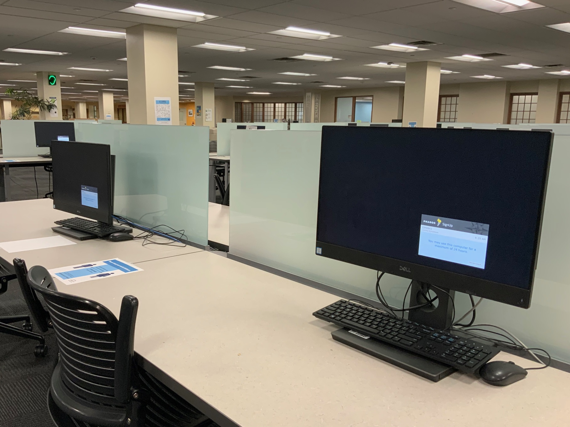
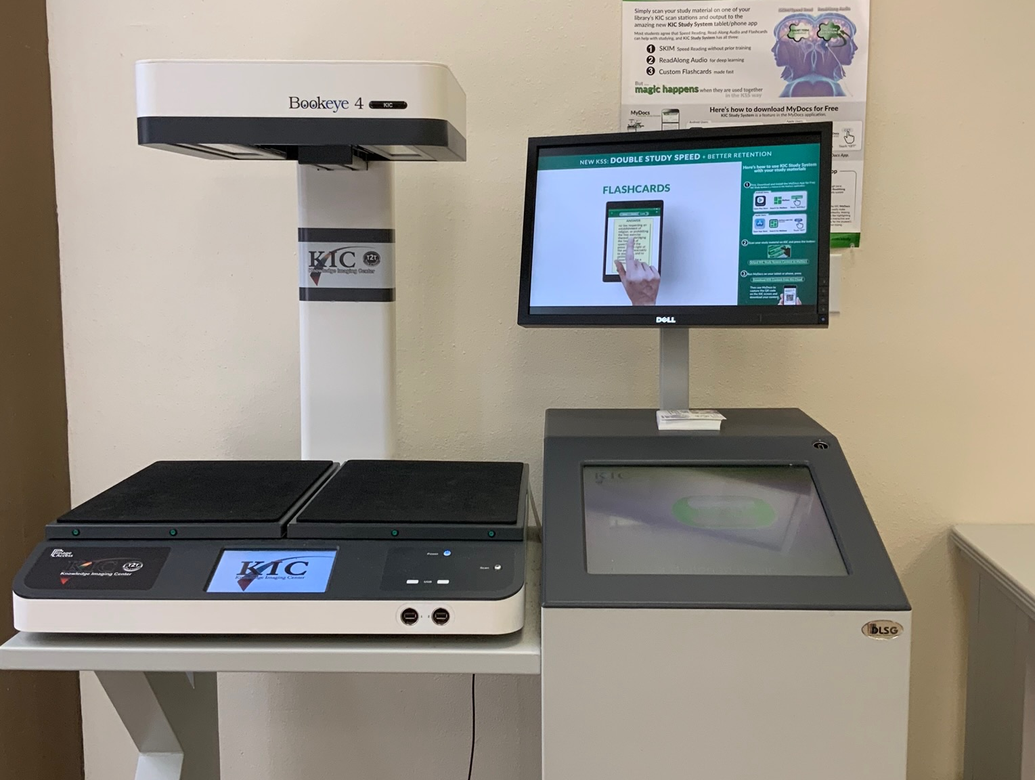
University Libraries GO Bonds have also been used for technology to support use of library resources

Slide 11
UNM Law Library
In FY22,the Law Library used its GO Bond money to purchase the West Academic Study Aids database
Electronic access to West Academic Study Aids is invaluable to our students; it provides electronic access to tools that first-year and upper class Law School students heavily rely on as tools in mastering legal analysis and deeper understandings of topics
With electronic access to these study aids, students can access and research them as needed without having to check out limited numbers of copies on course reserves
In 2021-2022, students accessed and viewed the West Academic Study Aids materials over 12,500 times!

Slide 12
Health Sciences Library & Informatics Center
Bond B helps pay for critical resources that train New Mexico’s next generation of healthcare providers
Makes up for gaps in funding when publishers' inflation outpaces increases to our annual collection budget
Enables us to focus on supporting students and student success

Slide 13
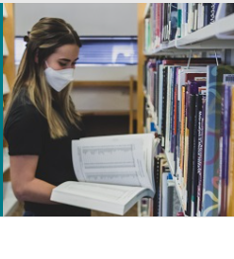
Health Sciences Library & Informatics Center: eJournals
Without the GO Bond, HSLIC would not have been able to provide access to as many valuable ejournals
GO Bond 2018 and 2020 provided $232,000 to fund ejournals for research and scholarship spanning all colleges and programs at the Health Sciences Center
This is approximately 6% of our annual ejournal cost
Some of our most used ejournals are:
The Lancet
Chest
Critical Care Medicine
Obstetrics & Gynecology

Slide 14
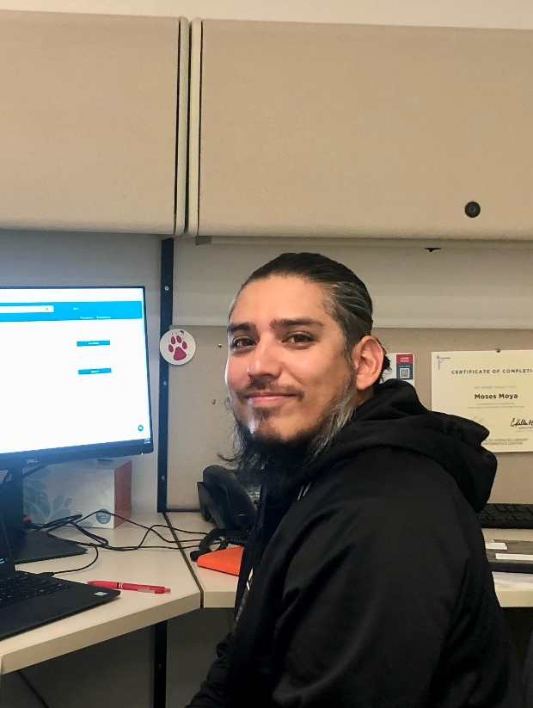
Health Sciences Library & Informatics Center: eBooks
Subscribed to 2 years of McGraw Hill’s:
AccessMedicine
AccessPharmacy
AccessPhysiotherapy
AccessAPN (Advanced Practice Nursing)
Go Bonds fund $125,000 of these resources; this is 48% of the total cost

Slide 15
How will this vote affect UNM?
If it passes
If it fails
NMCAL will continue sharing resources with academic libraries across the state, including access to databases such as CINAHL and Academic Search Complete
University Libraries, Law Library, and Health Sciences Library & Informatics Center purchases will support UNM program needs
Individual libraries will have to seek alternative funding to support access to databases like CINAHL and Academic Search Complete, meaning less funding for other resources
All Libraries will have less money to meet UNM programs' demands for up-to-date materials and resources

Slide 16
How will this vote affect UNM?
If it passes
If it fails
New and expanding UNM programs will have access to essential resources such as AccessAPN, which directly supports the new Doctor of Nursing Practice program and New Mexico’s initiative to expand the Nursing workforce
Access to some ejournals may be limited to past subscriptions and not include the most current articles

